Slide 1
COVID-Net: Covid-19 Detection on Lung CT Scans with Convolutional Neural Networks
Group-15: Project Final Evaluation

Slide 2
Contents
1
Motivation
Literature review
Data Acquisition effort
Dataset Preprocessing
Different Description and visualization
Convolution neural network (CovNet)
Basic CNN
VGG16
Methodology
Results and Analysis
Individual Team Members Contributions

Slide 3
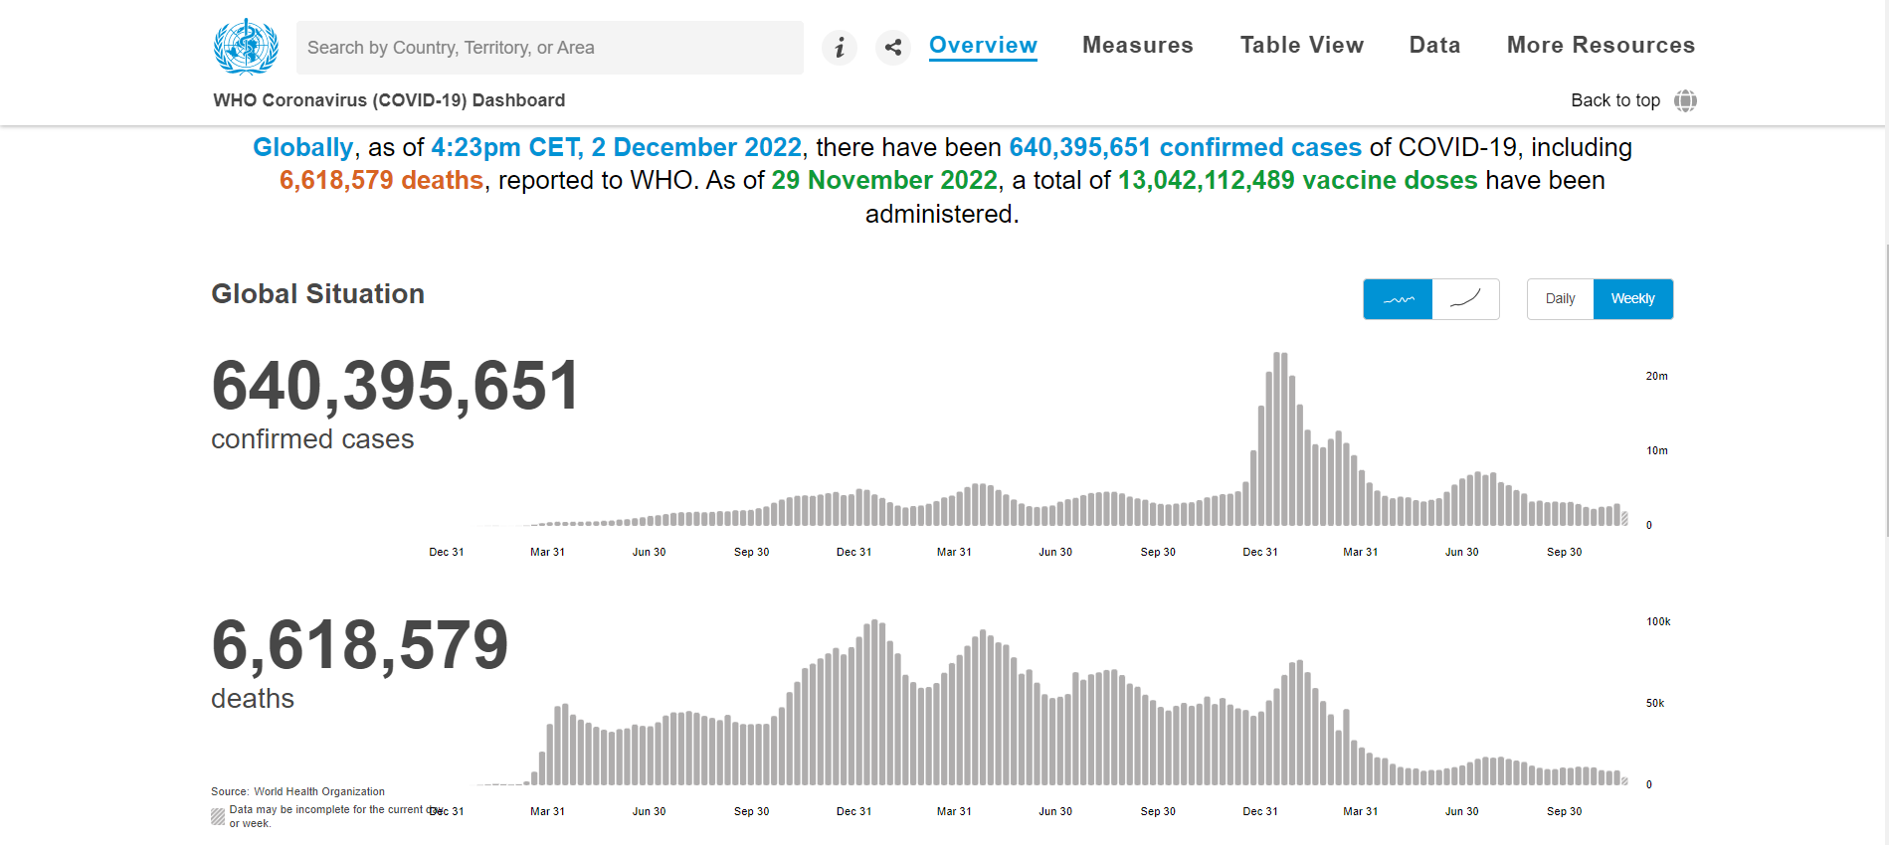
Motivation
2
Why COVID-19?
COVID-19 has tremendously impacted patients and medical systems globally.

Slide 4

Motivation
3
Why CT scan?
According to the Polish Journal of Radiology, CT scans are a relatively sensitive and fast tool and plays a crucial role in as a complementary screening method for distinguishing COVID-19 [3].

Slide 5
Motivation
4
What is the challenge?
Detecting COVID-19 in lung CT scans is a challenging task that relies on the availability of expert radiologists and their interpretation of CT scans for COVID-19 screening.
Our solution:
In this work, we present a model that aid in COVID-19 diagnosis by automatically detecting the impact of COVID-19 on lungs from CT scans [2].

Slide 6
Literature review: Paper-1
5
COVID-19 Detection on Chest X-Ray and CT Scan: A Review of the Top-100 Most Cited Papers.
COVID-19 has a high risk to the respiratory system. CXR and CT scans are the most commonly used image testing. During one of the analyses, a single image patch had no match for CNN, but when analyzed with a complete CT piece, the accuracy was less than that of CNN.
Main Argument

Slide 7
Literature review: Paper-1
6
COVID-19 Detection on Chest X-Ray and CT Scan: A Review of the Top-100 Most Cited Papers.
An analysis performed on COVID-19 classification using CNN acted as a feature extraction. This experiment was carried out on a publicly available dataset and gave an accuracy of about 99.4%
Conclusion

Slide 8
Literature review: Paper-2
7
COVID-19 detection from lung CT-scan images using a transfer learning approach
In this research paper, the effect of COVID-19 on human lungs has been discussed. It discusses how technology diagnoses COVID-19 using computed tomography (CT) lung scans.
Main Argument

Slide 9
Literature review: Paper-2
8
COVID-19 detection from lung CT-scan images using a transfer learning approach
COVID-19-infected patients show severe acute respiratory syndrome. The scientific community has tried to diagnose COVID-19 using computed tomography (CT) lung scans, because of its higher sensitivity in recognizing early pneumonic changes. Large datasets of CT-scan images are not publicly available due to privacy concerns. Thus, transfer-learning pre-trained models are used in the proposed methodology to classify COVID-19 (positive) and COVID-19 (negative) patients.
Challenge

Slide 10
Literature review: Paper-2
9
COVID-19 detection from lung CT-scan images using a transfer learning approach
They describe the development of a framework that includes pre-trained models (DenseNet201, VGG16, ResNet50V2, and MobileNet) as its backbone, known as KarNet. DenseNet201 achieved an accuracy of 97% for the test dataset, followed by ResNet50V2, MobileNet, and VGG16 (which achieved accuracies of 96%, 95%, and 94%, respectively).
Methodology

Slide 11
Literature review: Paper-2
10
COVID-19 detection from lung CT-scan images using a transfer learning approach
Machine learning techniques algorithms(ML) Convolution Neural Networks (CNN) have been applied in the healthcare sector for the analysis and prognosis of COVID-19. The model discussed concluded transfer learning is more beneficial for smaller datasets. The result of the experiments showed that transfer learning gives better results than CNN and other machine learning models.
Conclusion

Slide 12
Problem Formulation
Model Selection
11
We have to determine whether a patient has COVID-19 or not from their CT scan image. Since, we have to determine if the patient has COVID-19 or not it becomes a Binary classification problem.
As it is a binary classification problem to detect if a person is suffering from COVID-19 or not based upon the images of his lungs, thus we would be using CNN for training our dataset.

Slide 13

Data Acquisition
12
We have used an openly available database from Kaggle: COVID-19 Lung CT Scans, in which the images are collected from COVID19-related papers from medRxiv, bioRxiv, NEJM, JAMA, Lancet, etc. CT scans containing COVID-19 abnormalities are selected by reading the paper's figure captions. All copyrights of the data belong to the authors and publishers of these papers.

Slide 14
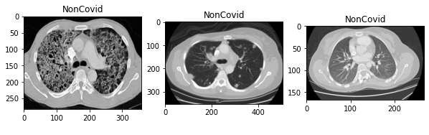
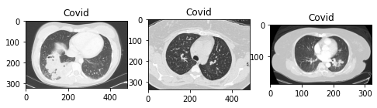
Data Description
13
349 CT Scans for Covid +ve
Samples
397 CT Scans for Covid -ve
Samples

Slide 15
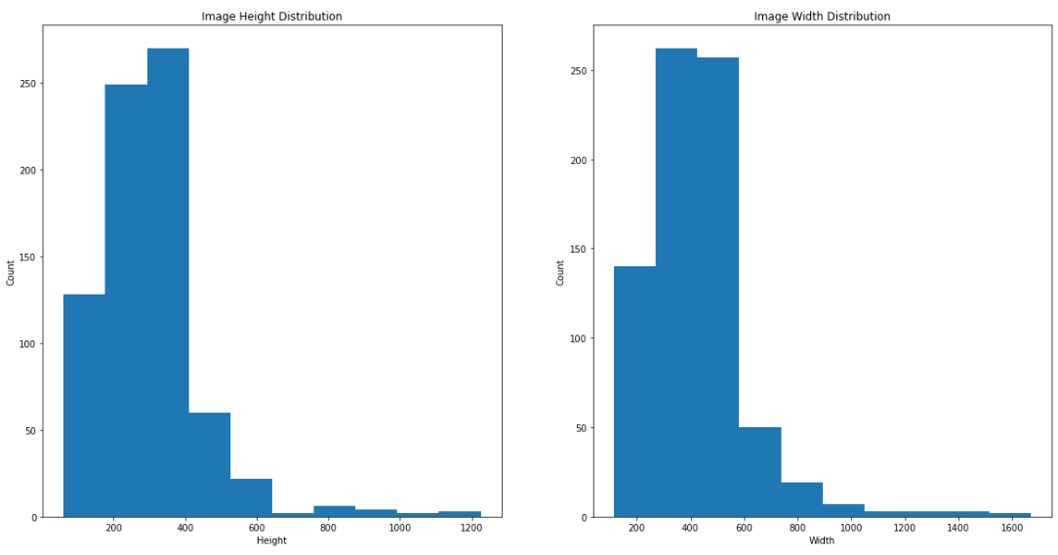
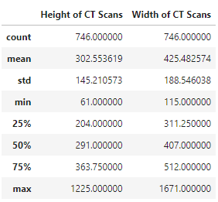
Dataset Description
14
Sample Space Image Details:

Slide 16
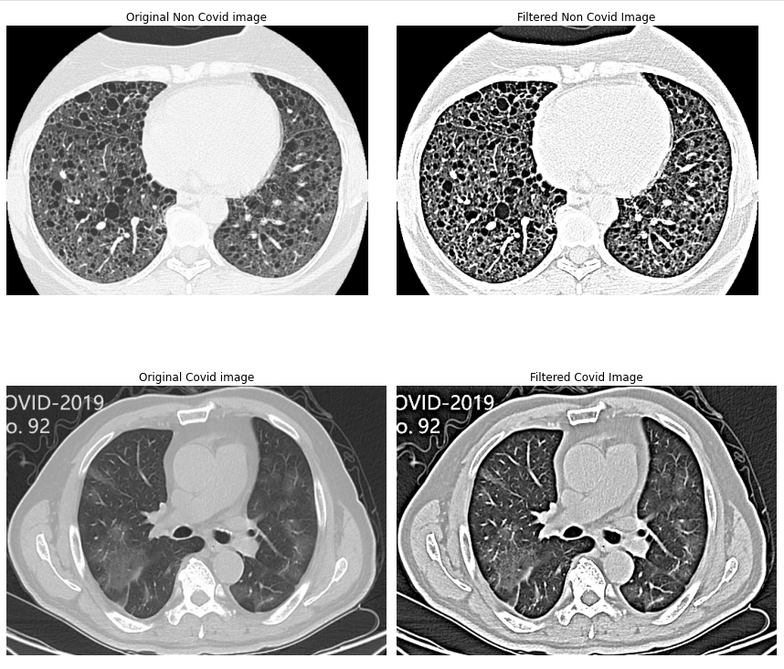
Data Visualization
(Filter Analysis)
15
Used the Unsharp Mask filter from skimage we try to create different masks to highlight regions of infection from the Covid Positive CT Scans.

Slide 17
Convolutional Neural Network (CovNet)
16
A convolutional neural network (CNN or CovNet) is one of the various artificial neural networks used for different applications and data types.
The built-in convolutional layer reduces the high dimension of images without losing its information.
Among various types of neural networks, including RNN, ANN, etc. CNN is widely used from all of the available options.
But for image processing itself, a fully connected neural network does not scale very well.
Sometimes due to the large number of parameters network stop attending to individual image details.

Slide 18
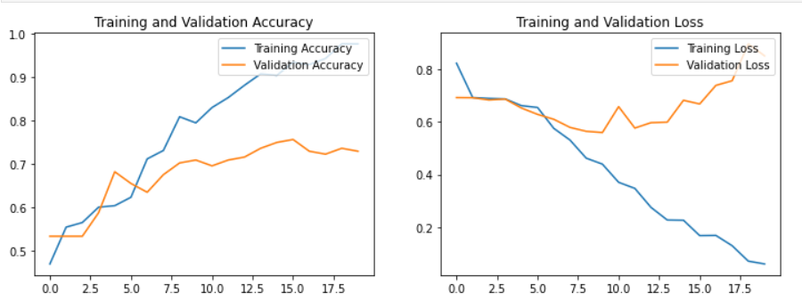
Basic CNN Model
17
In Basic CNN, what we did is we take; Training images (COVID): 280 Training images (Non COVID): 318, Testing images (COVID): 69 , Testing images (Non COVID): 79

Slide 19
Methodology
18
Find we did our training on basic CNN model , in which we got a good accuracy of 85% (almost) but F1-score was not quite satisfactory. Because of the low F1-score, we trained our model on special model called VGG16. In this model, we are training our dataset with 16 layers of CNN.

Slide 20
VGG16 Model
19
VGG-16 is a convolutional neural network that is 16 layers deep. And it's a bit semantic.
CNN is a concept of a neural network, Its main attributes may be that it consists of convolution layers, pooling layers , activation layers etc.
VGG is a specific convolutional network designed for classification and localization
Main Reason for using- This model has already learned features that are useful for most computer vision problems, and leveraging such features would allow us to reach a better accuracy than the previous method that we relied on.

Slide 21
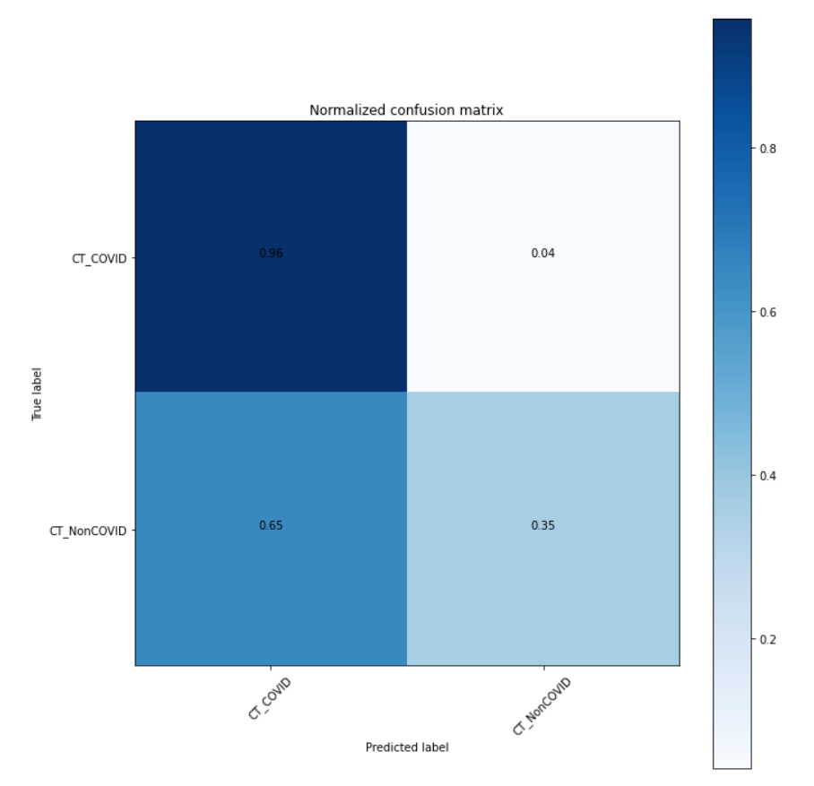

VGG16 Model
20
Generated a normalized confusion matrix for
testing. To check accuracy and f1-score of the
covid and non covid datasets.

Slide 22
VGG16 Model
21
After training of dataset on VGG16, we got good accuracy of 97% (almost) and our F1-score also become quite satisfactory. The F1-score we got is 77% (almost).

Slide 23
COVID-Net Model Architecture
22
COVIDNet or VGG16 is a 16-layer Dense Convolutional Network trained on the COVID-19 Lung CT Scans dataset.
Dense Convolutional Networks improve flow of information and gradients through the network, making the optimization of very deep networks tractable.
We replace the final fully connected layer with one that has a single output, after which we apply a sigmoid nonlinearity.
The weights of the network are initialized with weights from a model pretrained on ImageNet.
The network is trained end-to-end using Adam with standard parameters.
We train the model using mini batches of size 32.
We use an initial learning rate of 0.001.
We ran the model for 50 epochs.

Slide 24
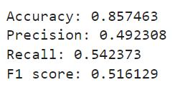
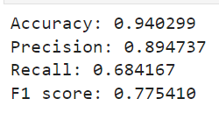
Results
23
For Simple CNN Model ->
Accuracy = 85.74% Precision = 49.23% F1 Score = 51.61
Avg F1 Score -> Bad Model
For VGG16 Model ->
Accuracy = 94.02% Precision = 89.47% F1 Score = 77.54
Good F1 Score -> Good Model

Slide 25
Conclusion
24
From our project above, we have learned how Convolution Neural Network (CNN) is used as an image recognition model and how it helped us to classify individuals as affected by COVID-19 or not by their lung CT scan. We observed that when we used the basic CNN model, our accuracy was a bit less but it got improved by the use of the VGG16 model. The accuracy of the model can be further improved with the help of transfer learning.

Slide 26
Individual Contributions
25
Team Members:
Aditya Choudhary - VGG16 Modeling, Analysis and Visualization
Akhil Sharma - Basic CNN Modeling, Analysis and Visualization
Shrugal Tayal - Literature review, Evaluation of new models to get better accuracy(CNN)
Vaibhav Rajpal - Dataset Preprocessing, Description and Visualization, Editing

Slide 27
References
26
[1]“CT Scan,” Mayo Clinic, 06-Jan-2022. [Online]. Available: https://www.mayoclinic.org/tests-procedures/ct-scan/about/pac-20393675 [Accessed: 04-Dec-2022]
[2]W. Zhao, W. Jiang, and X. Qiu, “Deep learning for COVID-19 detection based on CT Images,” Nature News, 12-Jul-2021. [Online]. Available: https://www.nature.com/articles/s41598-021-93832-2#:~:text=Owing%20to%20its%20high%20sensitivity,prediction%20compared%20to%20RT%2DPCR [Accessed: 05-Dec-2022]
[3]P. M. Sharif, M. Nematizadeh, M. Saghazadeh, A. Saghazadeh, and N. Rezaei, “Computed tomography scan in COVID-19: A systematic review and meta-analysis,” Polish journal of radiology, 05-Jan-2022. [Online]. Available: https://www.ncbi.nlm.nih.gov/pmc/articles/PMC8814899/[Accessed: 04-Dec-2022]
[4]A. Halder and B. Datta, “COVID-19 detection from lung CT-scan images using transfer learning approach - IOPscience,” COVID-19 detection from lung CT-scan images using transfer learning approach - IOPscience, Jul. 19, 2021. [Online]. Available: https://iopscience.iop.org/article/10.1088/2632-2153/abf22c[Accessed: Dec. 04, 2022]
[5]Y. M. Costa, S. A. Silva, L. O. Teixeira, R. M. Pereira, D. Bertolini, A. S. Britto, L. S. Oliveira, and G. D. Cavalcanti, “Covid-19 detection on chest X-ray and CT scan: A review of the top-100 most cited papers,” Sensors, vol. 22, no. 19, p. 7303, 2022. [Online] Available: https://www.mdpi.com/1424-8220/22/19/7303/pdf[Accessed: Dec 04,2022]

Slide 28

27

